Slide 1

SFWRTECH 4NS3 – Video Project #1 – Group 20
Multi-Factor Authentication (MFA)
What, Why, How, and Failure Modes
5 October, 2025
Notes:
We’ll define MFA, why it matters, common implementations, where it’s used, how attackers bypass it, and practical defenses.

Slide 2
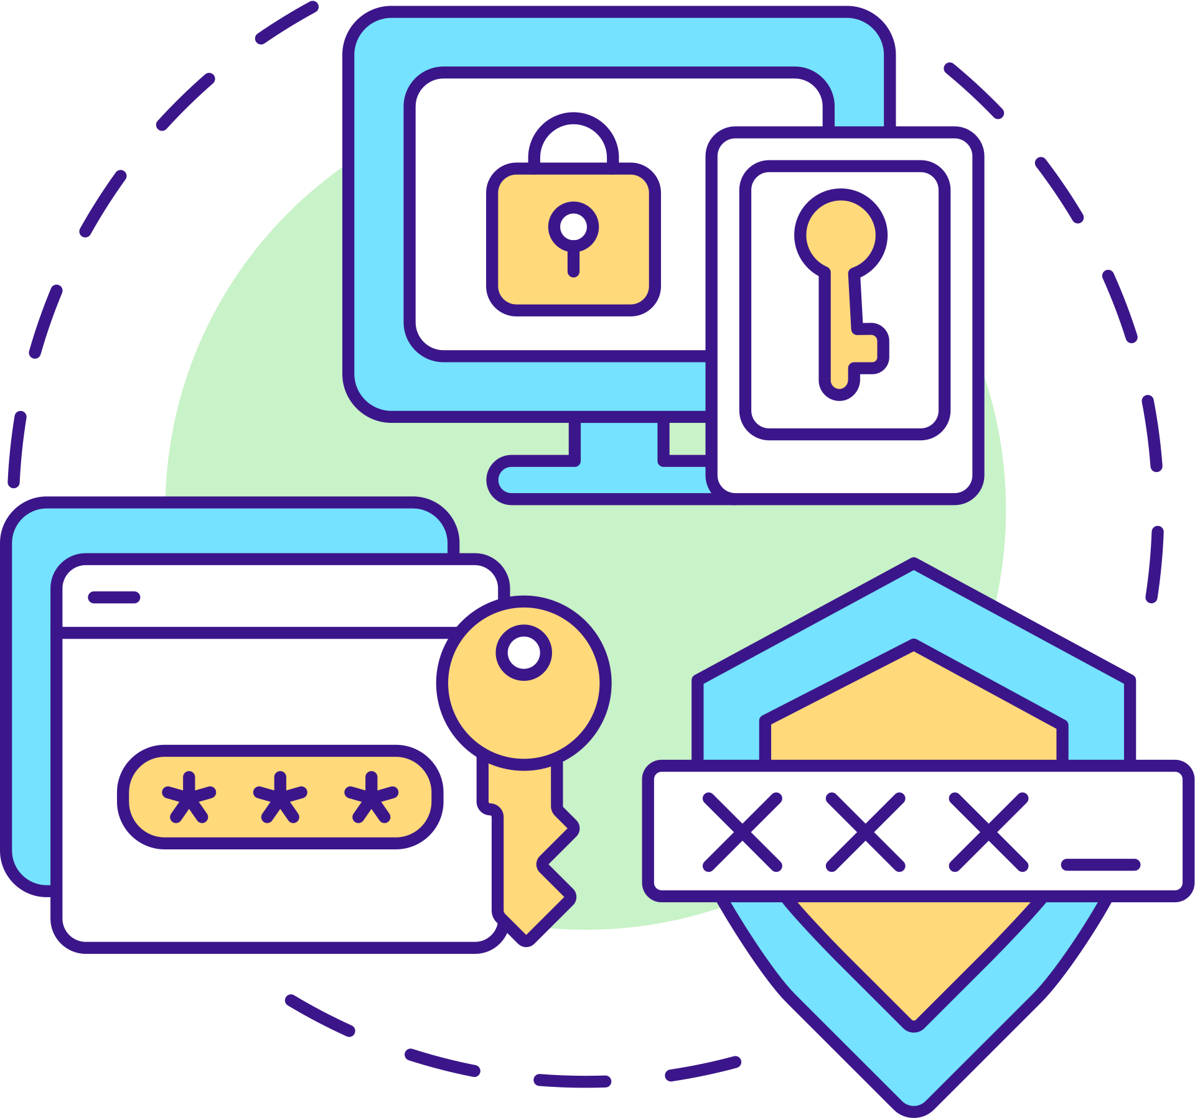
What MFA Is & Why It Matters
A baseline control against account takeover
MFA = use ≥2 independent factors to verify a user
Stops password-only attacks (phishing, stuffing, brute-force)
Reduces account takeover and breach blast radius
Baseline control in modern security programs
Often required by PCI / HIPAA / SOC 2
Notes:
MFA combines independent factors so a stolen password alone isn’t enough. It’s now a baseline control across orgs and compliance regimes because it materially reduces account-takeover risk.

Slide 3
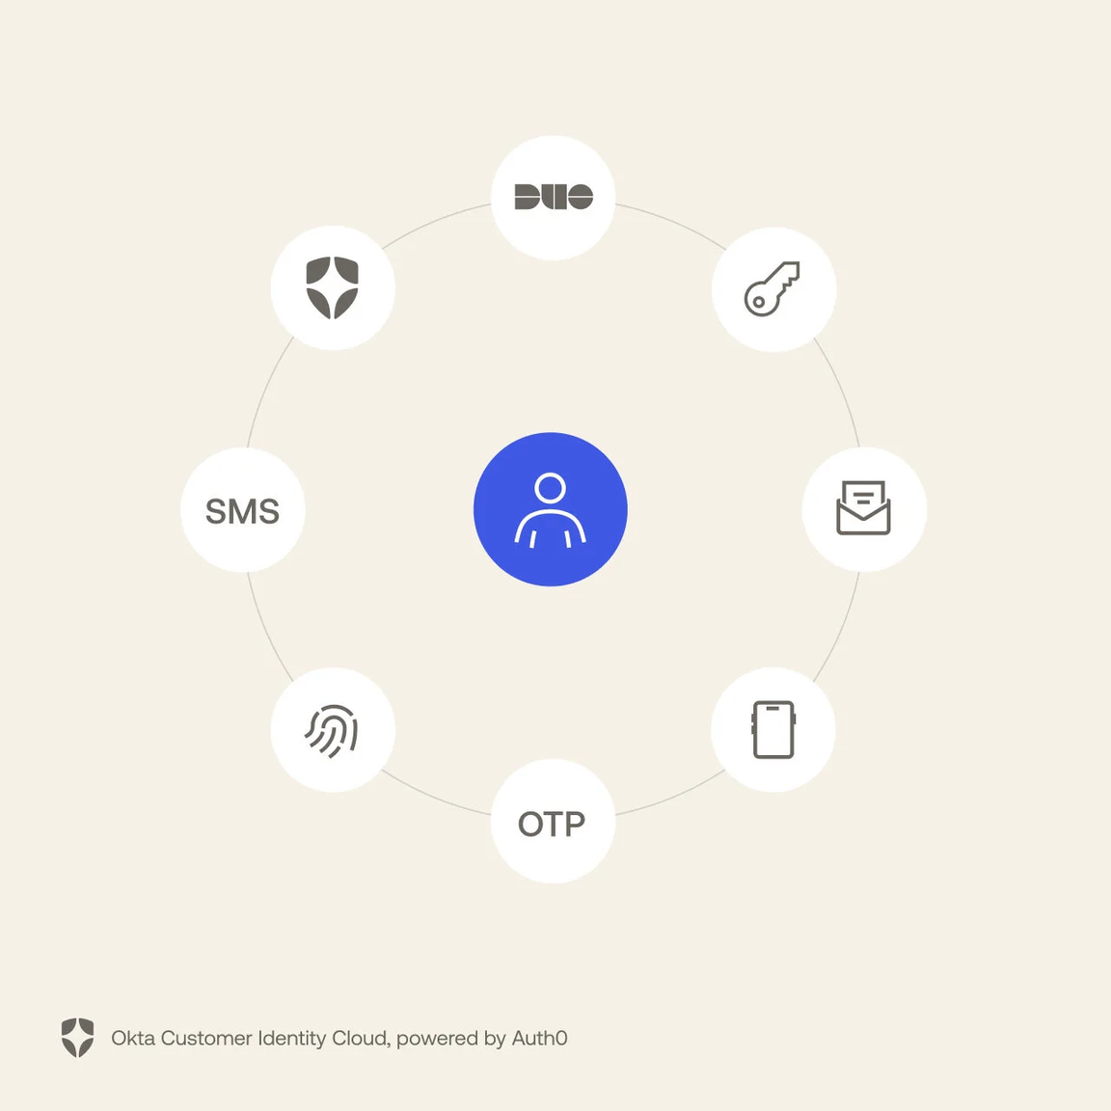
The Factors (and Strength)
Know: password, PIN
Have: authenticator app (TOTP), push prompt, hardware key
Are: biometrics (fingerprint, face)
Context (adaptive): device health, location/IP, time/velocity
Strength ladder: FIDO2/WebAuthn > push/TOTP > SMS/Email

Slide 4
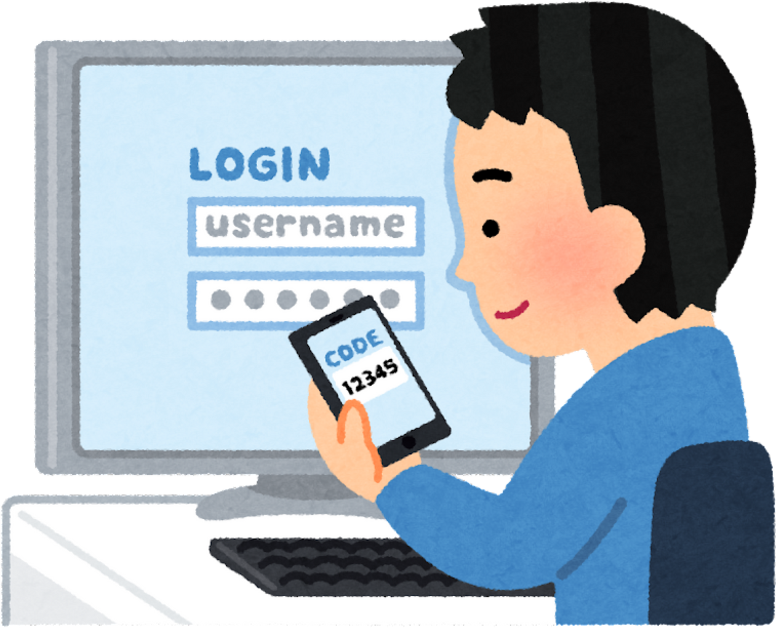
Implementation Patterns
SSO-centralized MFA: one policy across many apps
Step-up MFA: extra factor for sensitive actions
Risk-based prompts: challenge only when context is risky
Passwordless: device-bound credentials/biometrics
Recovery: backup codes/helpdesk — lock down tightly
Notes:
Good deployments balance security with usability. Risk-based prompts and step-up checks cut friction. Treat recovery like a high-risk pathway.

Slide 5
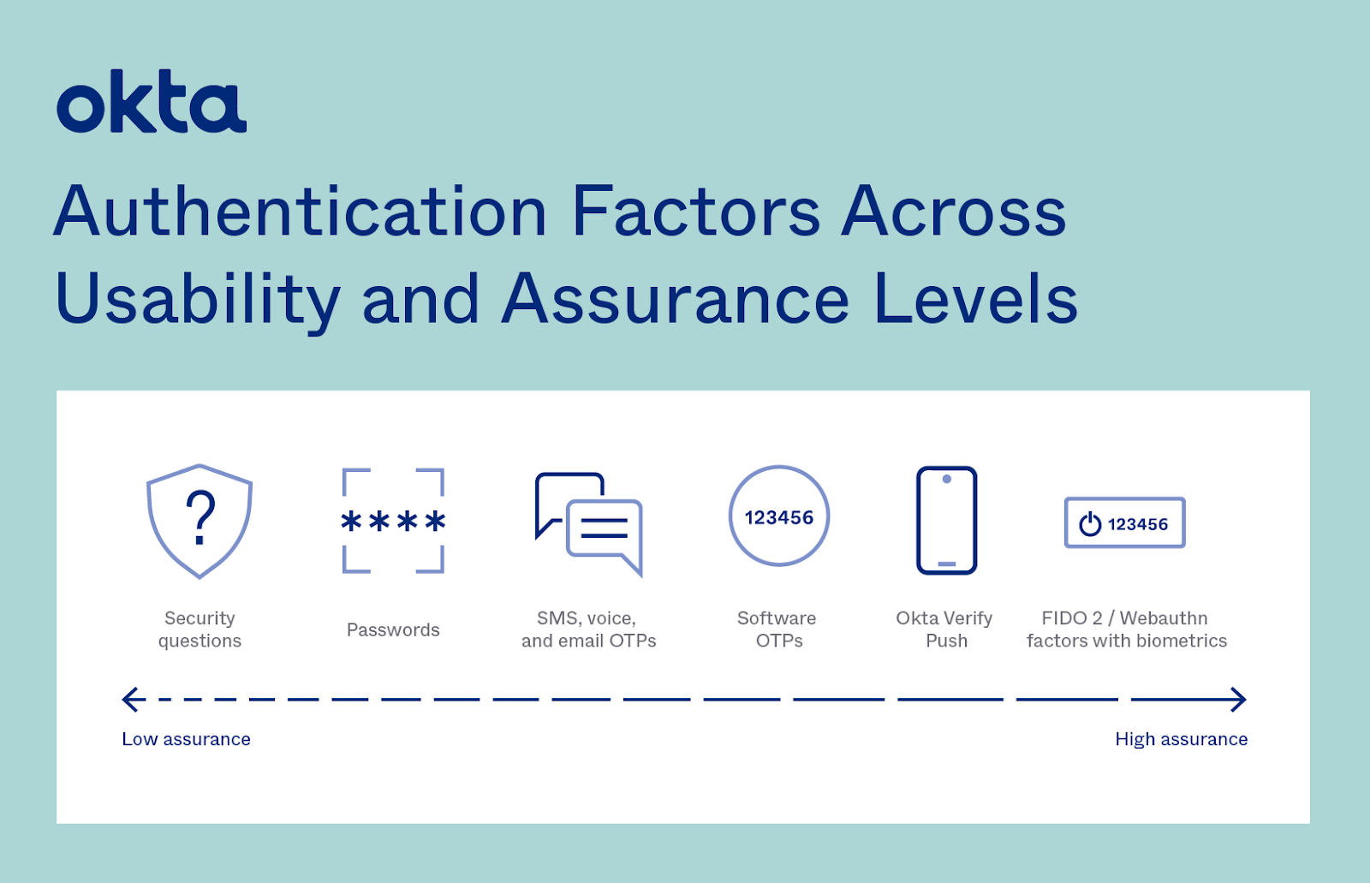
Notes:
https://www.okta.com/blog/identity-security/what-is-two-factor-authentication-2fa/
source

Slide 6
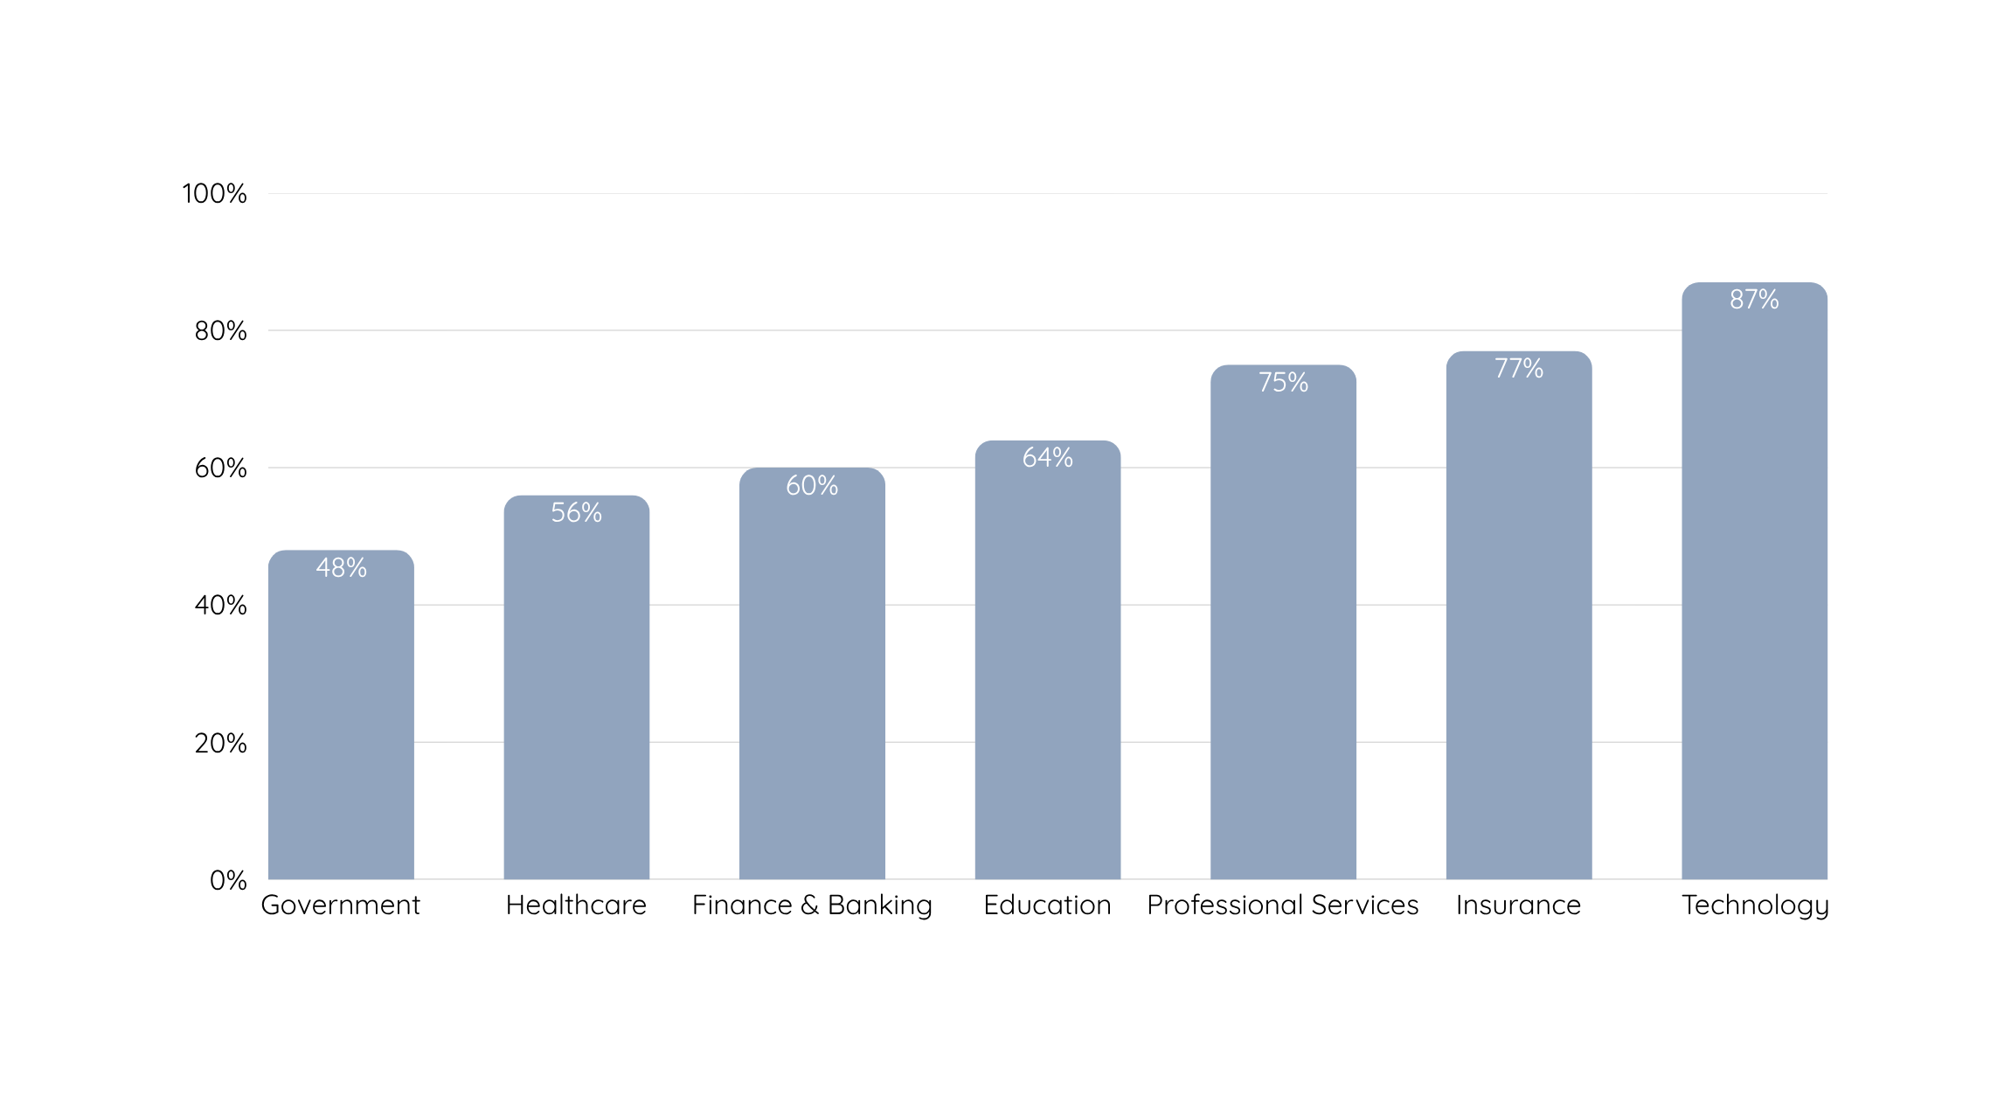
MFA Adoption by Industry
(Reference: scoop.market.us)
Notes:
https://electroiq.com/stats/multifactor-authentication-statistics/
source
As of 2024, in the technology industry, Multi-Factor Authentication Adoption is very high at 87%.
The insurance sector follows with a 77% adoption rate, while professional services and education secured an adoption rate of 75% and 64%, respectively.
In finance and banking, where strict security is essential, MFA is used by 60% of organisations.
Healthcare and government sectors have slightly lower adoption levels, at 56% and 48%, individually.

Slide 7
Bypass Tactics vs. Defenses
1) Phishing / MITM (steals OTP or session cookie)
Defense: Use phishing-resistant auth (FIDO2/WebAuthn or platform biometrics); disable legacy OTP where possible; bind creds to origin; shorten session/token lifetimes; require step-up re-auth for sensitive actions.
2) MFA Push Fatigue (“push bombing”)
Defense: Enable number-matching/challenge on pushes; rate-limit and add cool-offs after repeated prompts; alert on abnormal prompt volume; educate users to deny unexpected prompts; escalate to a stronger factor on risk.
3) SIM Swap (SMS OTP interception/port-out)
Defense: Avoid SMS for MFA; prefer authenticator app (TOTP) or hardware keys; require a carrier PIN/port-freeze; notify on phone/SIM changes; restrict factor resets with strong identity proofing and audit.
Notes:
MFA isn’t magic. The most effective defense is phishing-resistant auth plus sane policies: throttle prompts, avoid SMS, and harden recovery.

Slide 8
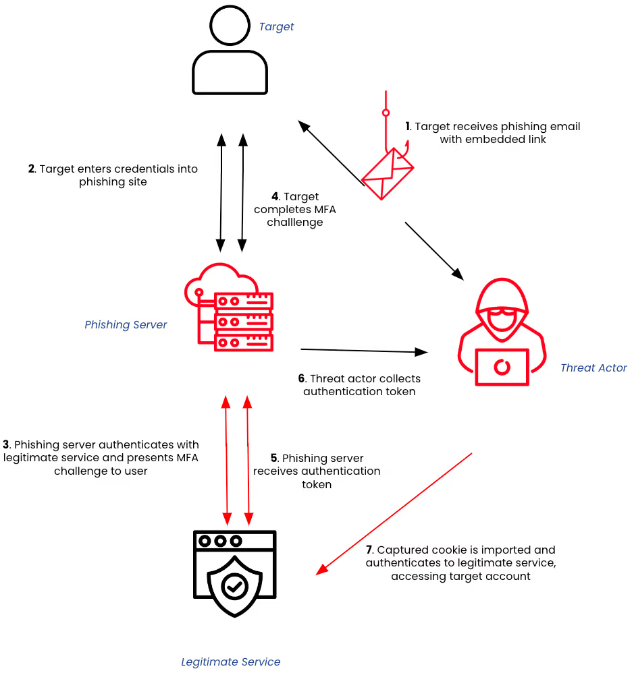
High-level example of how a token theft attack can take place
Source: ZeroFox Intelligence
Notes:
MFA isn’t magic. The most effective defense is phishing-resistant auth plus sane policies: throttle prompts, avoid SMS, and harden recovery.

Slide 9
Thank you

Slide 10
Citations
https://www.okta.com/products/multi-factor-authentication/
https://www.zerofox.com/blog/social-engineering-mfa-bypass-via-phishing/
https://www.okta.com/blog/identity-security/what-is-two-factor-authentication-2fa/
https://electroiq.com/stats/multifactor-authentication-statistics/
https://scoop.market.us/multi-factor-authentication-statistics/

